Slide 1

Mindsky
Intelligent Mental Health Assessment & Crisis Response Platform — Bridging the gap between self-assessment and clinical support through AI, automation, and real-time emergency response.
CAPSTONE PROJECT
MICROSERVICES ARCHITECTURE

Slide 2

The Problem We're Solving
Mental health crises are global — yet the tools to address them remain fragmented, inaccessible, and reactive, leaving billions without structured, intelligent support.
1B+
0
People Affected
Seamless Bridge
Live with a diagnosable mental health disorder globally
Between self-reporting symptoms and real-time crisis intervention
∞
Care Gap
Severe global shortage of psychiatrists and psychologists

Slide 3
What Is Mindsky?
A fully containerised, production-grade microservices platform delivering end-to-end mental health support — from initial screening to emergency dispatch.
Psychological Screening
AI Clinical Summaries
Automated GAD-7 and MSPSS assessments with intelligent domain routing
Personalised insights generated via a RAG pipeline using LangChain and Groq
Gamified Engagement
Crisis Response
XP, streaks, and mood tracking to encourage consistent mental health habits
Real-time Twilio SMS/Voice dispatch with PostGIS geospatial routing

Slide 4
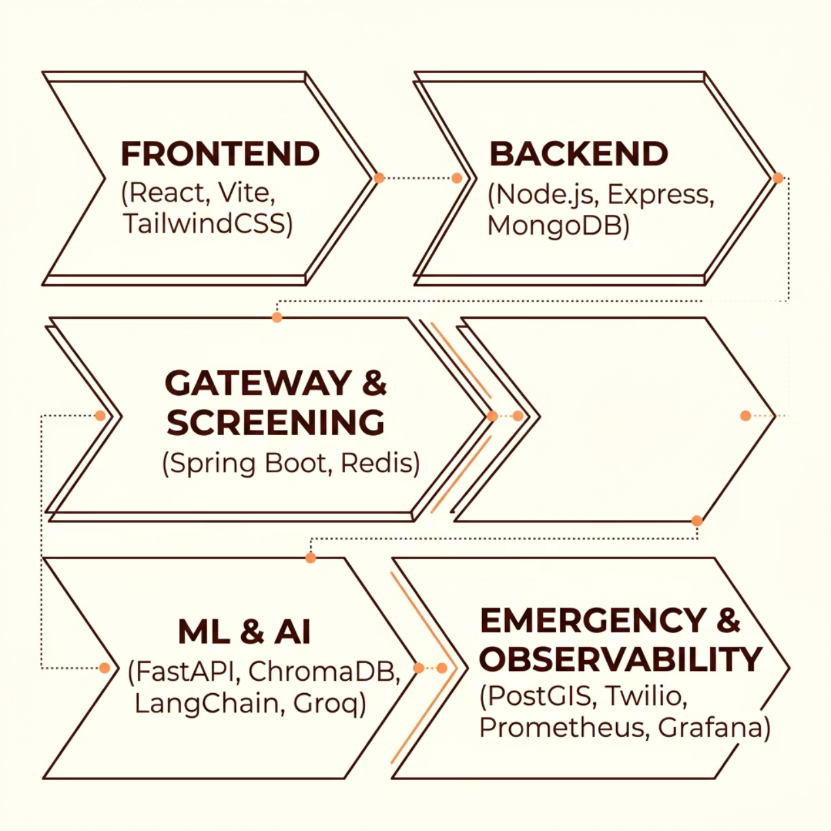

System Architecture
Nine independent microservices communicate over a Docker internal network, each encapsulating a distinct domain responsibility.
Nine Microservices
Each service is independently deployable, fault-isolated, and communicates through well-defined internal APIs — ensuring resilience and scalability at every layer.
Frontend
Gateway
ML Engine
Emergency
React 19 + Vite
Spring Boot + Redis
FastAPI + Transformers
PostGIS + Twilio

Slide 5
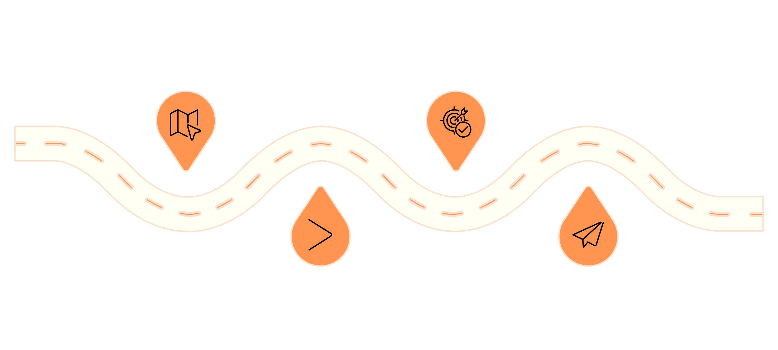
ML Screening Engine
ZERO-SHOT CLASSIFICATION
No labelled training data required. The engine uses cosine similarity over sentence embeddings to dynamically select the most relevant psychological questionnaire for each user.
Encode
Identify
Embed user response with all-MiniLM-L6-v2
Select highest-scoring psychological domain
Compare
Route
Compute cosine similarity to prototype banks
POST /classify to deliver targeted questionnaire
Easily extensible — adding new psychological domains requires only new prototype statements, with no model retraining.

Slide 6

AI Service & RAG Pipeline
Context-Aware Clinical Insight Generation
01
Request Ingestion
Assessment results submitted to the FastAPI AI service
02
ChromaDB Retrieval
Top 6 clinically relevant documents retrieved via all-mpnet-base-v2 embeddings
03
Prompt Construction
Structured clinical prompt assembled with context and user history
04
LLM Call & Validation
Groq/OpenRouter API generates response, validated against AiServiceResponse schema. Prometheus tracks latency and failures.

Slide 7

Emergency Crisis Response
Real-Time Geospatial Dispatch
When a crisis is detected, Mindsky triggers immediate action — resolving the user's district via PostGIS spatial queries and dispatching support via Twilio.
Voice Support
SMS Routing
Geolocation
POST /crisis/call triggers Twilio voice dispatch
POST /crisis/sendSms resolves district via PostGIS
GET /crisis/locate/district provides reverse geotagging using full Indian district GeoJSON dataset

Slide 8




Gamification & User Engagement
Consistent engagement is the foundation of long-term mental wellness. Mindsky uses a reward-driven loop to motivate daily participation.
Journal & Reflect
Accumulate XP
50 XP per entry
Every 1000 XP = level up
Track Streaks
Level Up & Celebrate
Daily streak and emoji mood tracking
Animated milestone screens

Slide 9
Dashboard, DevOps & Observability
User Dashboard
Production Infrastructure
A rich, insight-driven interface delivering holistic mental health context at a glance.
Containerisation
Kubernetes
Docker Compose with persistent volumes for MongoDB, Redis, PostGIS, ChromaDB, and Grafana
Full manifests, dynamic secrets from .env, automated deploy.sh / teardown.sh scripts
Monitoring
Prometheus + Grafana + cAdvisor — including LLM latency and validation failure tracking
Clinical Insights
Wellness Tools
AI summary, severity explanation, key findings, and personalised recommendations
Journal viewer, ambient sound player, emoji mood log, and mini-games

Slide 10

Results & What's Next
Achievements
Future Roadmap
9 Microservices
Mobile App
Fully integrated, from onboarding to crisis dispatch
Cross-platform iOS and Android experience
Zero-Shot ML
Therapist Dashboard
No labelled training data — fully extensible classifier
Clinician-facing portal for longitudinal patient tracking
District-Level Routing
Multi-Language Support
PostGIS geospatial emergency coverage across India
Expanding access across linguistic communities
Built to care. Engineered to scale. — Mindsky demonstrates that thoughtful AI and robust engineering can meaningfully close the global mental health care gap.

